Slide 1
Software Architecture Assignment #2
Name : JOHN PAUL NAVEEN ROZARIO R
Email : 2022mt93667@wilp.bits-pilani.ac.in
ID : 2022mt93667

Slide 2
Spotter
Choose your fitness program

Slide 3
Purpose of the System
Provide fitness programs
Group Exercise classes, Personal Training, etc.
Managing employees, salaries, vacations, payments

Slide 4
Spotter
Top 3 ASR’s
Availability System Reliability Fault Tolerance
Scalability Load Balancing
Elasticity
Security Data Privacy
Authentication & Authorization

Slide 5
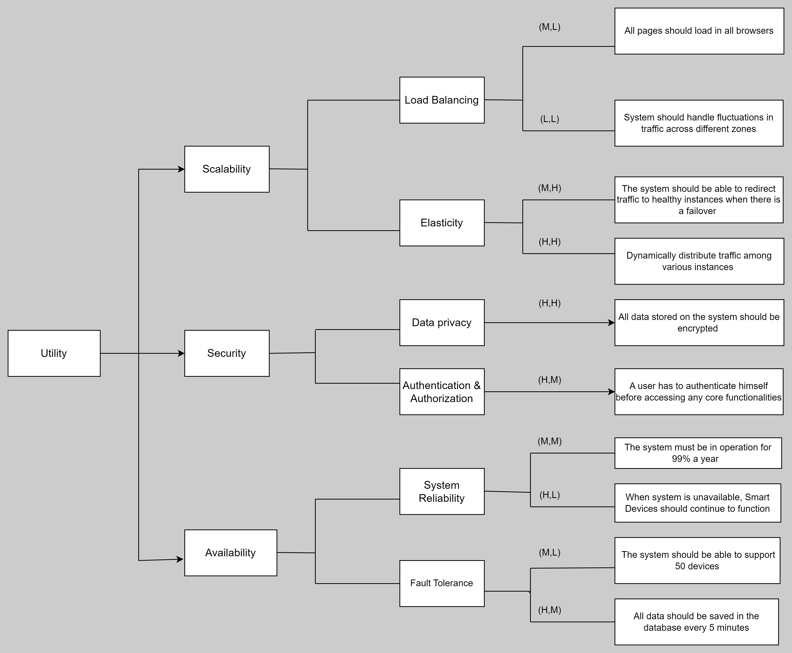
Spotter
Utility Tree

Slide 6
Spotter
Tactics used to achieve the ASRs
Availability:
System Reliability: Utilize microservices architecture to ensure that individual components can be updated or maintained without affecting the entire system. Implement health checks and monitoring to detect issues early.
Fault Tolerance: Use redundancy (e.g., multiple instances of critical services) and fallback mechanisms (e.g., circuit breakers) to handle failures gracefully.
Scalability:
Load Balancing: Use a load balancer (e.g., AWS Elastic Load Balancer) to distribute incoming requests evenly across available instances of services.
Elasticity: Implement auto-scaling (e.g., using AWS Auto Scaling or Kubernetes) to dynamically adjust the number of instances based on demand.
Security:
Data Privacy: Encrypt sensitive data at rest (using tools like AWS KMS) and in transit (using TLS/SSL). Implement proper access control mechanisms to limit data access.
Authentication and Authorization: Use OAuth 2.0 and OpenID Connect for secure user authentication and role-based access control.

Slide 7
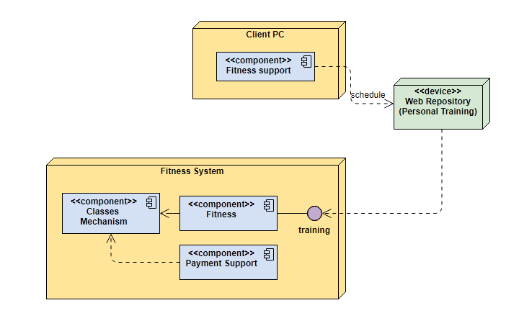
Spotter
Deployment Diagram

Slide 8
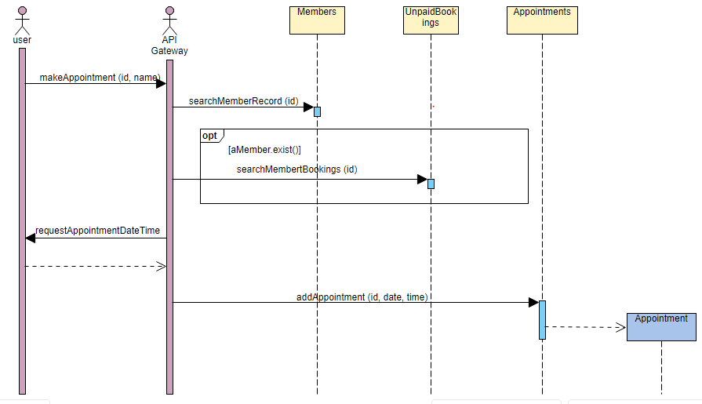
Spotter
Sequence Diagram
Scenario: Syncing appointment data between the tracker and the cloud.

Slide 9
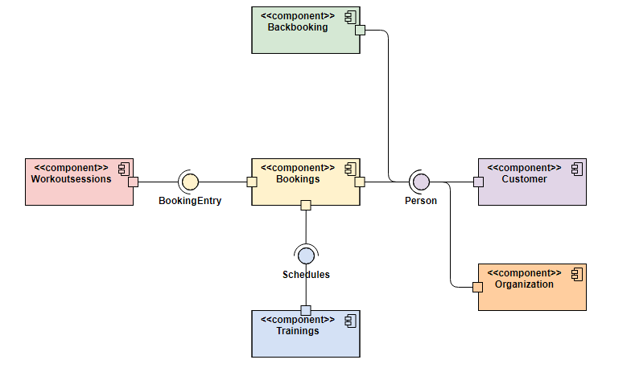
Spotter
Component & connection Diagram

Slide 10
Spotter
Architecture Pattern
Microservices: The system is composed of small, independently deployable services, enabling better scalability and maintainability.
AWS Cloud : AWS allows users to build, deploy, and manage applications and services using a flexible and cost-effective pay-as-you-go mode
Event-driven architecture: The system reacts to events generated by users or devices, allowing for asynchronous and decoupled communication between components.
CQRS (Command Query Responsibility Segregation): Separate components handle write (command) and read (query) operations, improving performance and scalability.

Slide 11
Spotter
Key Learnings
The significance of identifying ASRs and aligning them with system requirements and user needs.
The process of selecting and implementing tactics to address ASRs, ensuring a robust and scalable architecture.
The role of architectural patterns in guiding the design and organization of the system, improving its overall maintainability and extensibility.

